Slide 1
ACTIVON
Manuka Honey Barrier Cream

Slide 2
NHS & Clinician Requirements for Barrier Cream
✓
Create an effective moisture barrier must remain in place after 1 ‘wash’
Easy to apply using nitrile gloves
Dries within 1 minute
Leaves a non-tacky residue
Effective moisturiser
Leaves a residue that secondary dressings will adhere to
Non flammable
Does not stain clothing or bedding
✓
✓
✓
✓
✓
✓
✓
Notes:
We set out an internal test protocol that took into account all of these factors and then tested the various formulas we developed against Cavilon, Medicatre Plus, Medihoney and Revamil + petroleum jelly as a control substance.
In the tests we were either comparable or better than competitive solutions.
The two chemical-based competitors dried to a more permanent barrier that was easier to adhere, but this is because they either contain silicone or plastinating agents.
This can be overcome with simple reapplication after each incidence of incontinence, where you would expect to clean up anyway.
Our crème perfumed noticeably better in drying time than both the competitive honey products and was reported to small better.

Slide 3
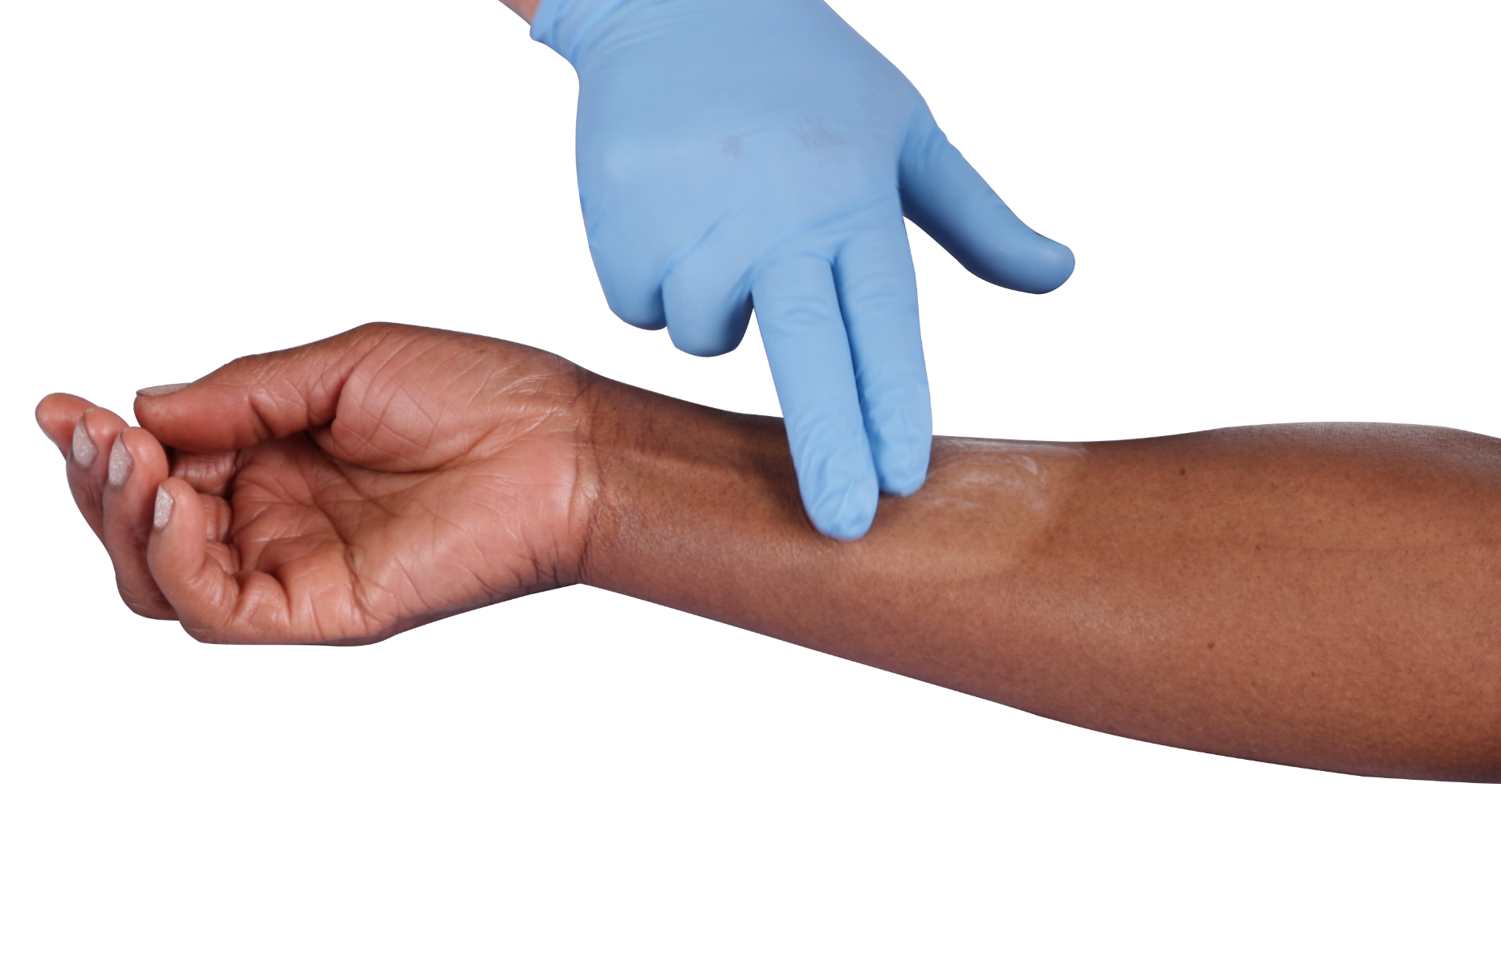
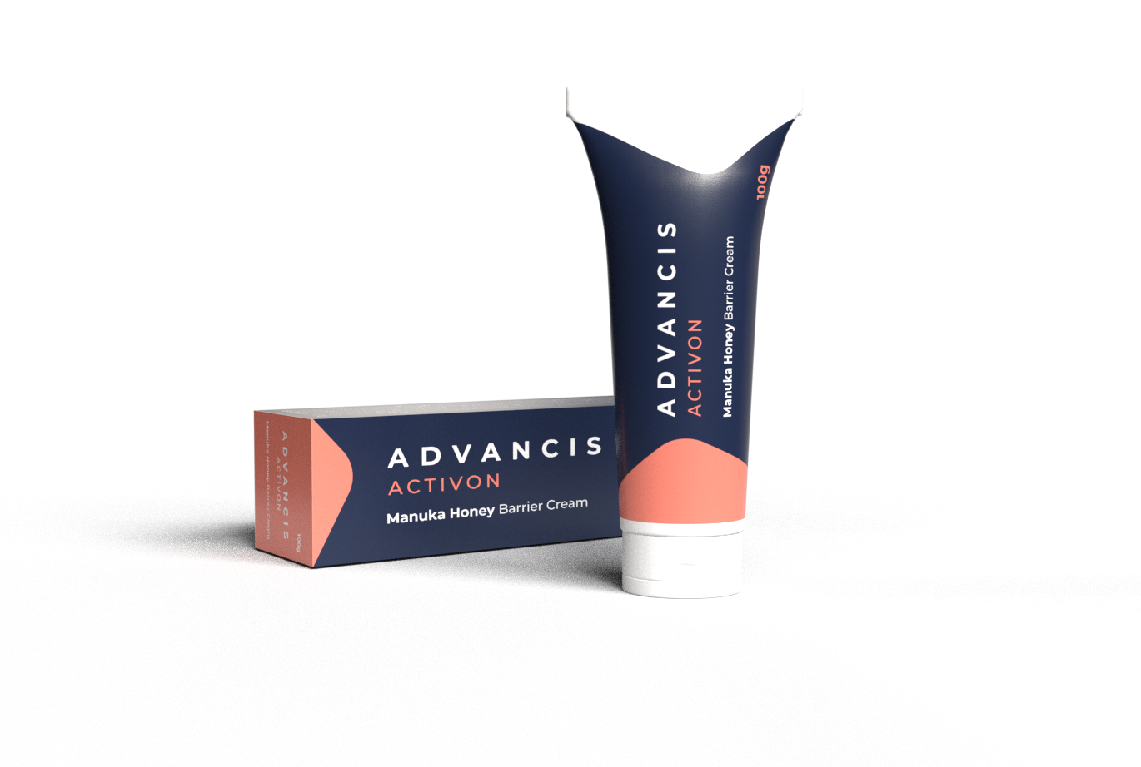
ACTIVON BARRIER CREAM
^{Manuka Honey Barrier Cream}
Activon Manuka Honey Barrier Cream is an effective barrier against perspiration, urine and stool and wound exudate that lasts up to 24 hours.*
The formula is designed to assist with the prevention of Moisture Associated Skin Damage (MASD), it contains Medical Grade Manuka Honey to reduce soreness and Cocoa Butter to aid with moisture retention.
Stock Code | Size | Pack Size
CR4546 | 100 | 1

Slide 4
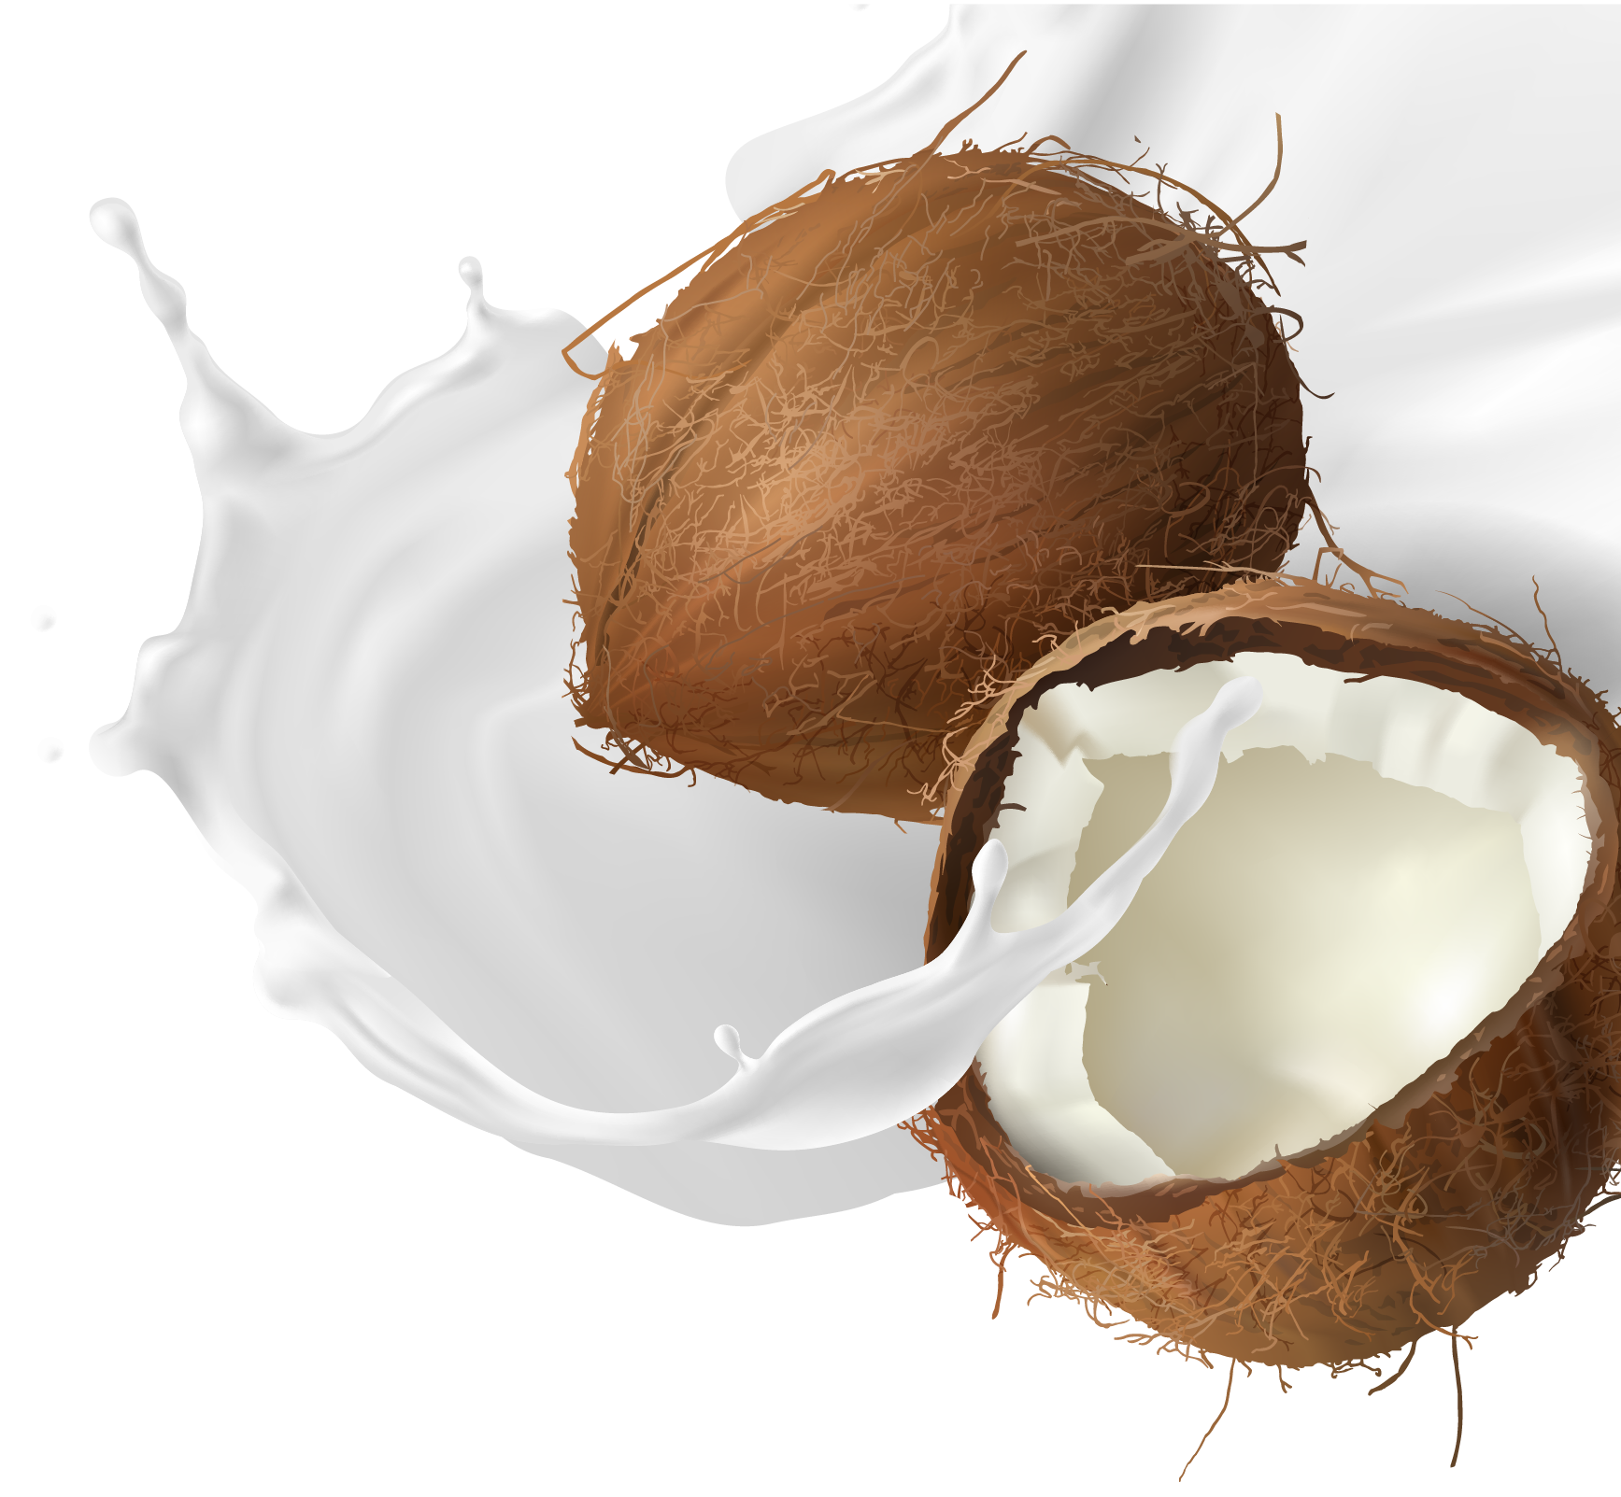
Formulation – What do the ingredients do?
Base ingredient is Aqua. As with all emollients and barrier creams, it needs to be a liquid, the amount of water effects viscosity
Manuka honey (25%). Anti inflammatory and therapeutic benefits
Glycerine. Primary moisture barrier ingredient
Cocoa butter, Castor Oil and Cetyl Alcohol. Moisturises and helps form a moisture barrier
Sodium Stearoyl Lactylate, Glyceryl Stearate, Xanthan Gum. Emulsifying thickening and stabilising.
Phenylethyl Alcohol & Ethylhexylglycerin. Preservatives
Notes:
The exact formulation and mixing technique is proprietary and will remain that way to protect our IP.
However, we are now obliged to disclose the so you can under
All of these are natural plant based or naturally ocuccing ingredient with the exception of the preservatives.

Slide 5
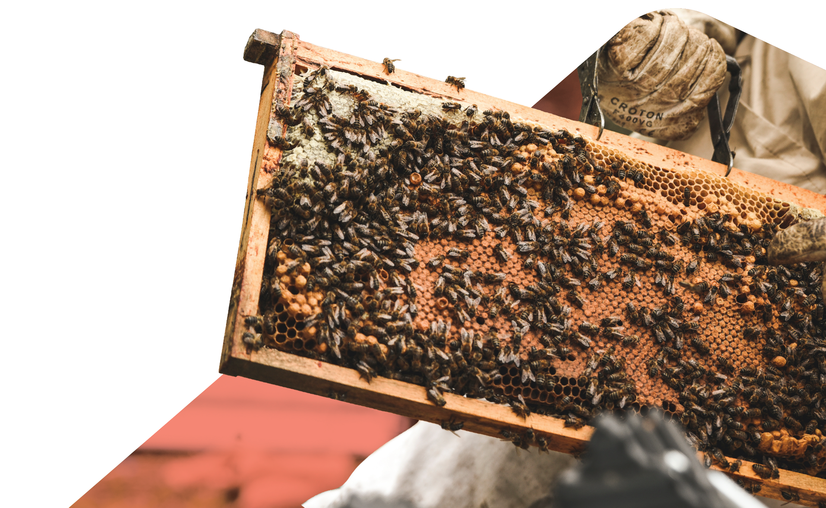
Products Features
25% Medical Grade Manuka Honey
Barrier cream USP (almost)
Anti-inflammatory properties
Reduced odour
Aids the healing process
Antibacterial???
Notes:
By adding honey to the barrier cream we are adding a selling point that only two other creams on the market currently share – and the future of one of those is in question.
Honey is antibacterial, so even at 25% concentration the

Slide 6
Products Features
No highly flammable ingredients
Many barrier creams contain paraffin or petrolatum
This is dangerous around any naked flame (cooking, smoking etc)
Incompatible with oxygen therapy
Note: MHRA warning about fabric buildup
Notes:
Mediderma S contains petrolatum Cavilon contains paraffin. Clinicians are keen to avoid this risk.

Slide 7
Products Features
99% Natural Ingredients
Only preservatives are chemicals
No parabens or phthalates
Potential risks to hormone production and fertility
No added fragrances
Reduced risk of allergic reactions
Notes:
By adding honey to the barrier cream we are adding a selling point that only two other creams on the market currently share – and the future of one of those is in question.

Slide 8
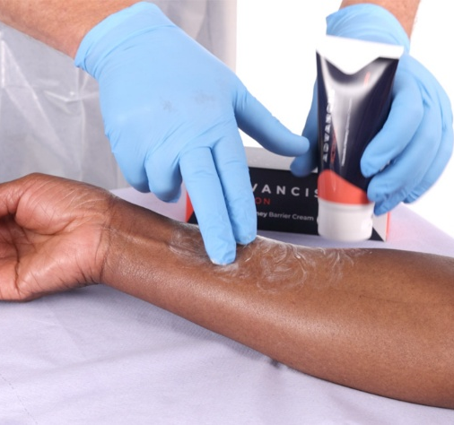
Products Features
Easy to Apply
Even, smooth texture
Pea to palm size ratio
Spreads easily with naked hand or using nitrile gloves
Easy to achieve an even distribution of a thin layer
Notes:
By adding honey to the barrier cream we are adding a selling point that only two other creams on the market currently share – and the future of one of those is in question.

Slide 9
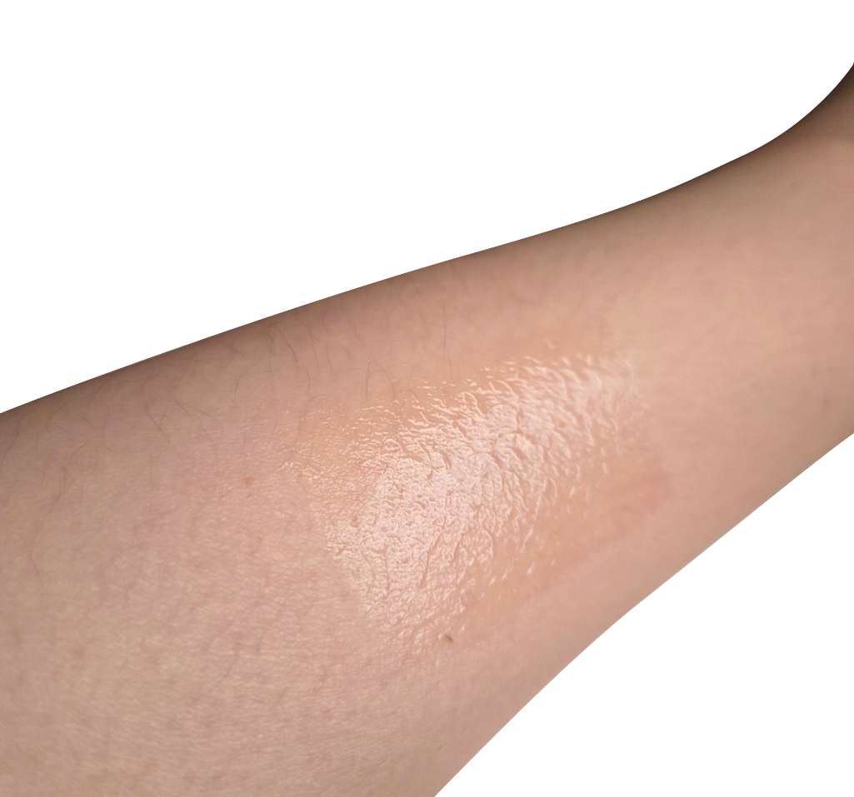
Products Features
Dries quickly
Sub 1 minute drying time
Leaves a visible ‘shiny’ barrier film on the skin surface
Easy to clean off and quickly re-apply if neccessary
Notes:
By adding honey to the barrier cream we are adding a selling point that only two other creams on the market currently share – and the future of one of those is in question.

Slide 10
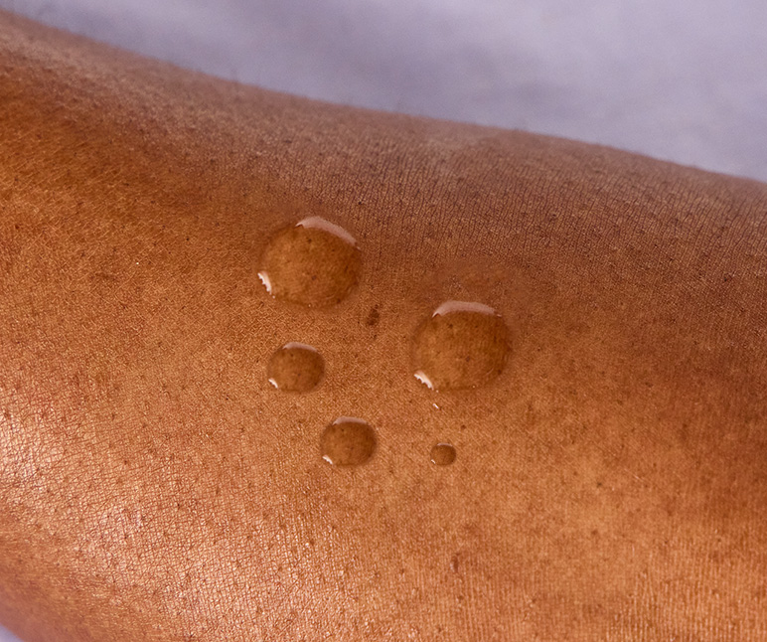
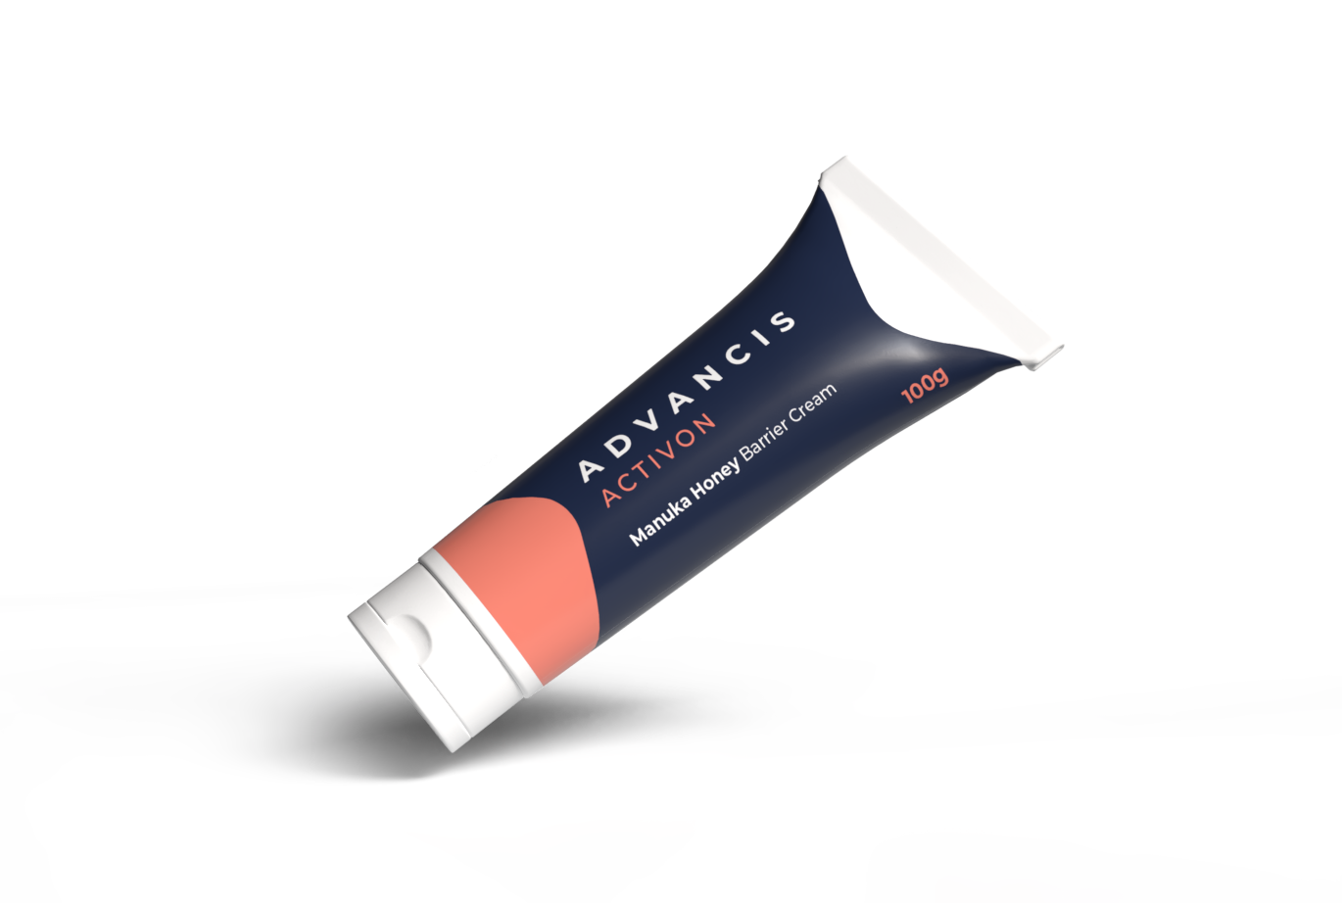
Products Features
Creates a stable moisture barrier
Survived wash test and immersion test with visible residue remaining
Notes:
By adding honey to the barrier cream we are adding a selling point that only two other creams on the market currently share – and the future of one of those is in question.

Slide 11
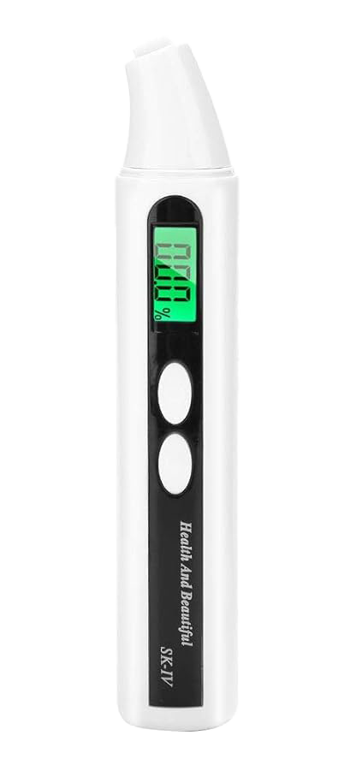
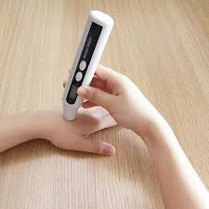
Products Features
Moisturises
Contains Cocoa Butter
Skin hydration levels increased during testing
Notes:
By adding honey to the barrier cream we are adding a selling point that only two other creams on the market currently share – and the future of one of those is in question.

Slide 12
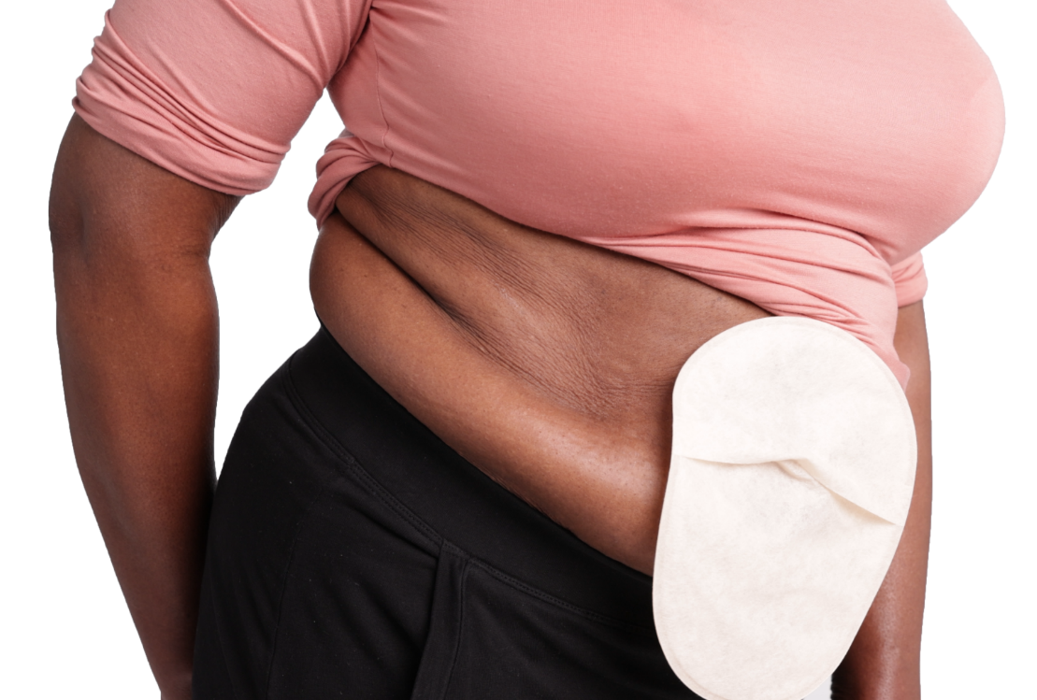
Products Features
Compatible with secondary dressings and Ostomy solutions
Does not prevent adhesion of other products
Notes:
By adding honey to the barrier cream we are adding a selling point that only two other creams on the market currently share – and the future of one of those is in question.

Slide 13
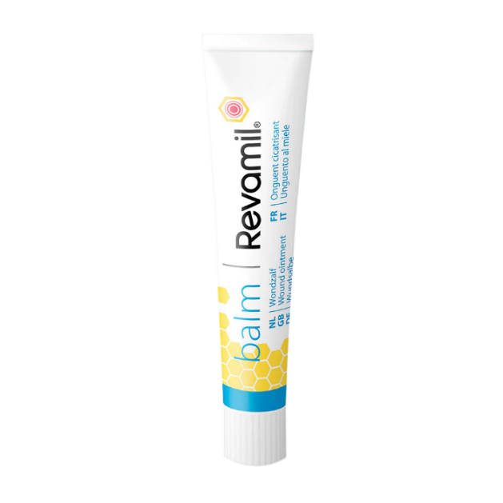
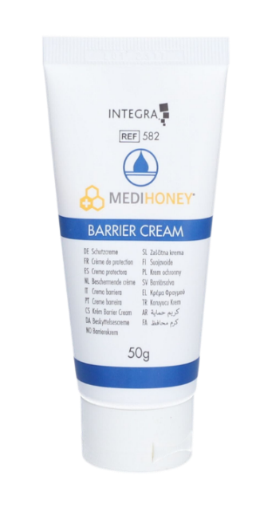
Honey Barrier Creams Comparison
Contains Peanut Oil
Not Manuka honey – honey origin and type undisclosed
Takes a long time to dry - if at all
Hard to attach secondary dressing or ostomy
Small tubes
Will Revamil survive the MDR transition?
30% Manuka honey
Contains Coconut oil
Less natural, contains silicone and Cetomacrogol
Doesn’t dry quickly
Reportedly unpopular aroma
50g tubes and sachets only
Uncertain future
Availability issues
25% Manuka honey
Dries in less than 1 minute
100g tubes for community use
99% natural
New
Zero availability issues
MDR compliant

Slide 14
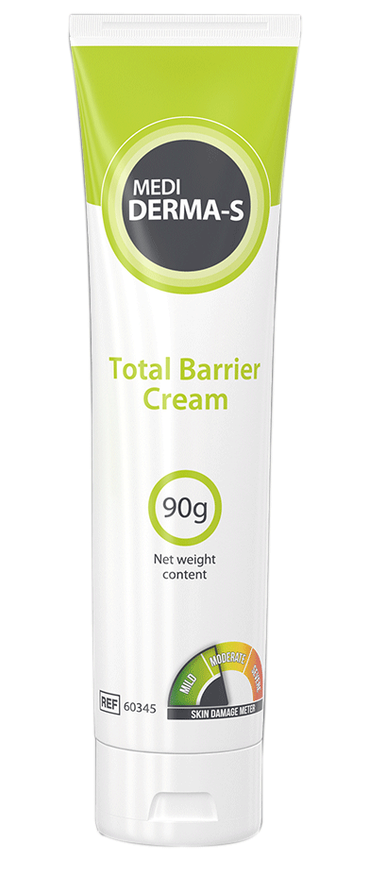
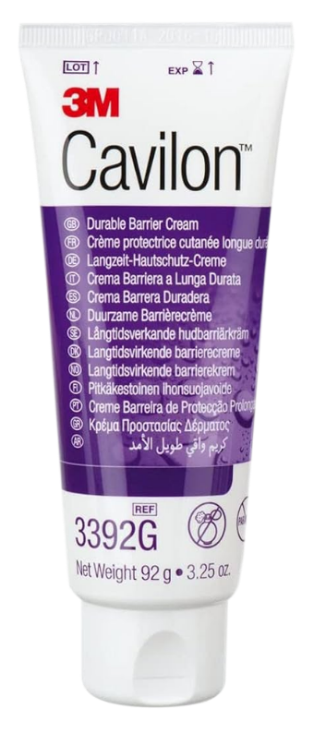
Incumbent Barrier Creams Comparison
Natural with therapeutic benefits
Chemical based, no therapeutic benefits
Contains Petrolatum (flammable)
Contains Trimethylsiloxysilicate (silicone resin)
Contains Paraffin (flammable)
Contains Diisooctyl Adipate (plastinator)
Contains Glycerine and Castor Oil (natural)
Notes:
These are all going to dry better than our and make a more permanent moisture barrier, but they are a chemical stew and have no therapeutic benefits.

Slide 15
Non-Sterile Barrier Cream Application Guide
Skin Condition | Risk Factors | Primary treatment Focus | Secondary Treatment Focus | Treatment Choice
NORMAL INTACT SKIN | Dry skin, elderly skin, oedema, feacal and or urinary incontinence, peristomal and periwound care | Preventing moisture | Protection from risk factors | Barrier Cream
ERYTHEMA OR MODERATE DERMATITIS WITH NO BROKEN SKIN | Dry skin, elderly skin, oedema, feacal and or urinary incontinence, peristomal and periwound care | Protection from further damage | Prevention (maintain moisture balance) | Barrier Cream
BROKEN, SEVERE DERMATITIS, EXCORIATED WEEPOING SKIN, PRESSURE ULCERS GRADE 2 & 3 | Dry skin, elderly skin, oedema, feacal and or urinary incontinence, peristomal and periwound care | Protection from further damage | Prevention (maintain moisture balance) | Sterile Barrier Film, wipes or spray

